Slide 1
File Management
A guide to manage files in Jupyterlab user interface

Slide 2
Objectives
Identify and name the file browser in JupyterLab and explain its UI elements.
Perform general file management tasks

Slide 3
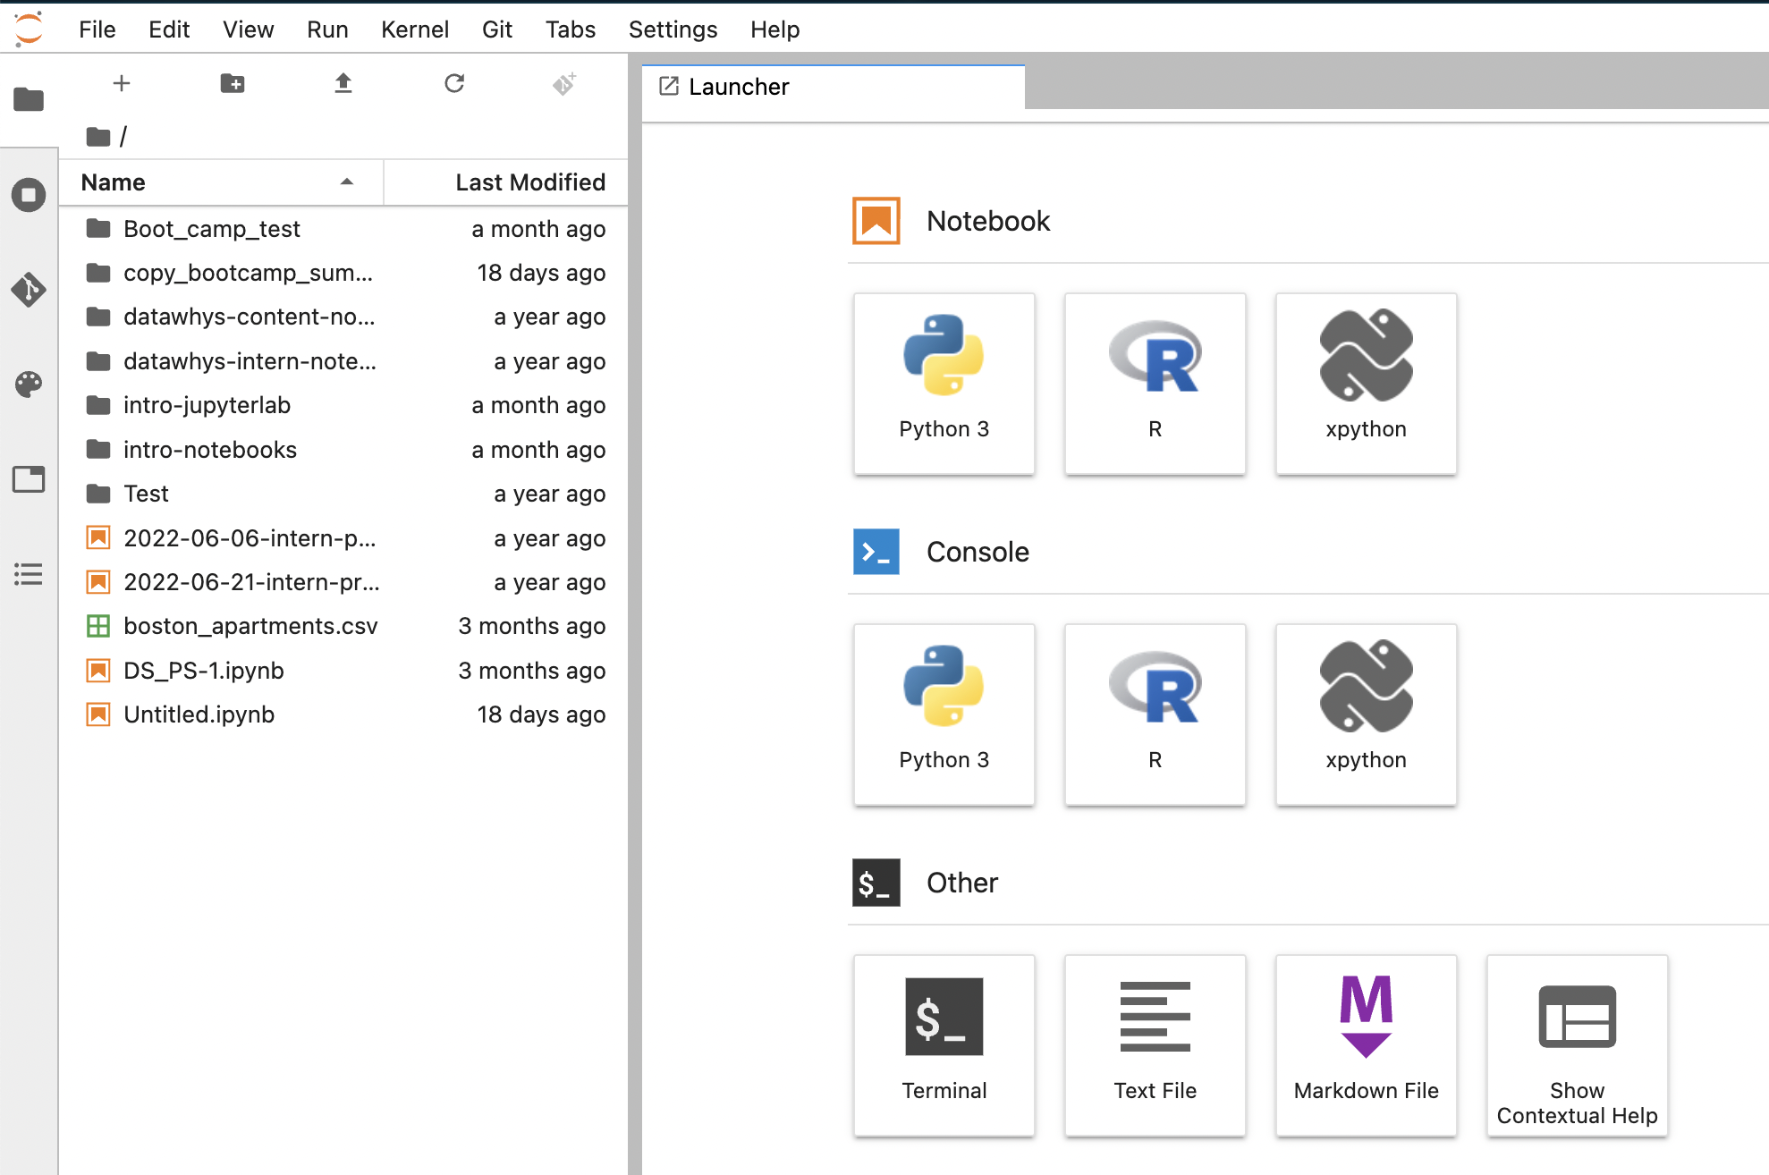
Menu Bar
Notebook
Launcher
Console
File Browser
File browser showing the file system/structure

Slide 4
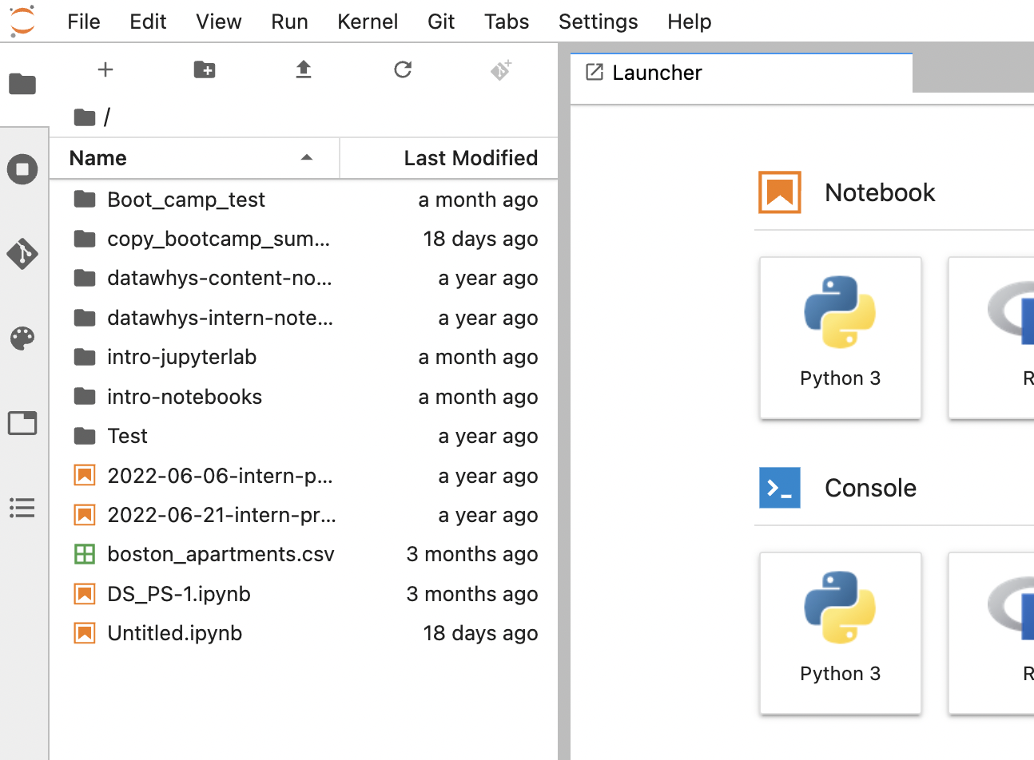
File Browser Details
New Launcher
New Folder
Upload Files
Refresh File List

Slide 5
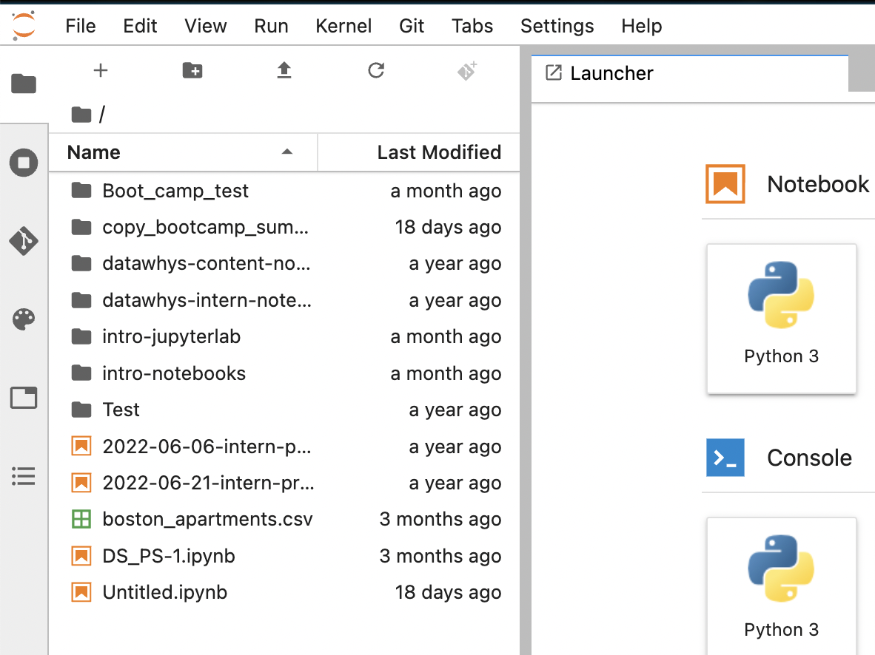
Hide/Unhide File Browser Details
Click on the File Browser to hide/unhide the file browser details

Slide 6
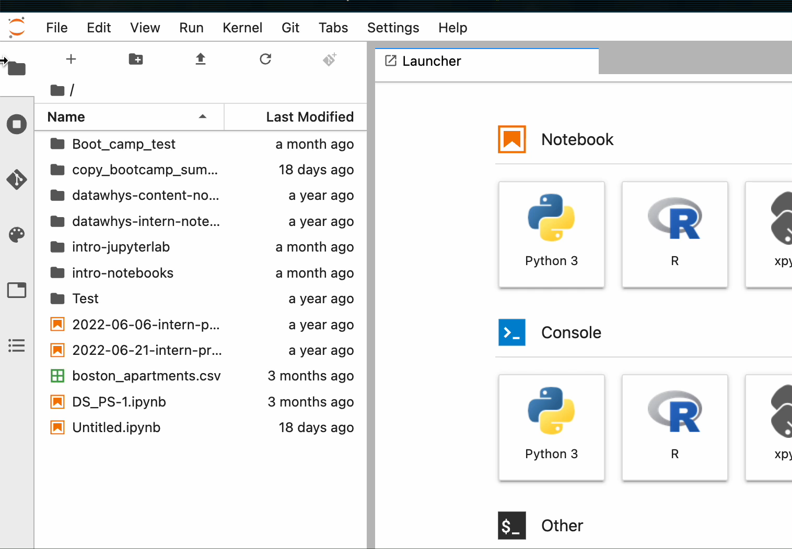
Hide/Unhide File Browser Details
Click on the File Browser to hide/unhide the file browser details

Slide 7
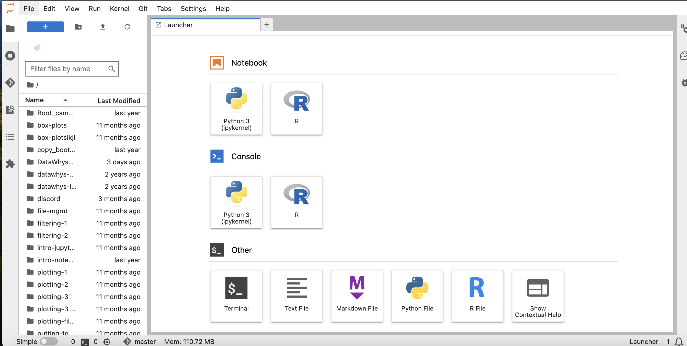
Creating python file from launcher
Create a new python notebook. Select the Python 3 option which is the kernel that we will work on.

Slide 8
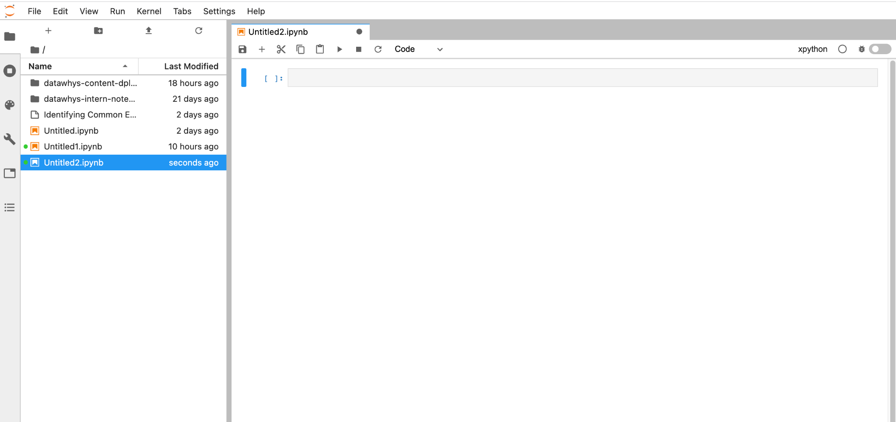
Open created python file
Double click on the notebook you want
To open

Slide 9
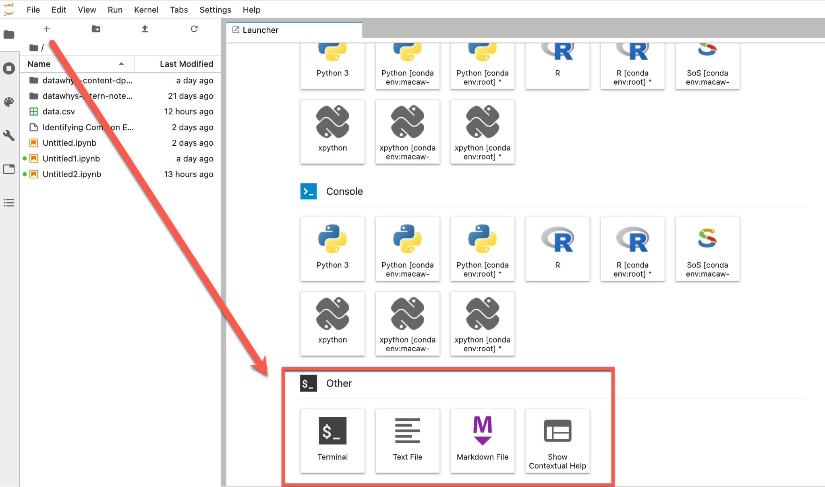
Opening other file types
You can also open other files such as terminal, text files etc. from the launcher

Slide 10
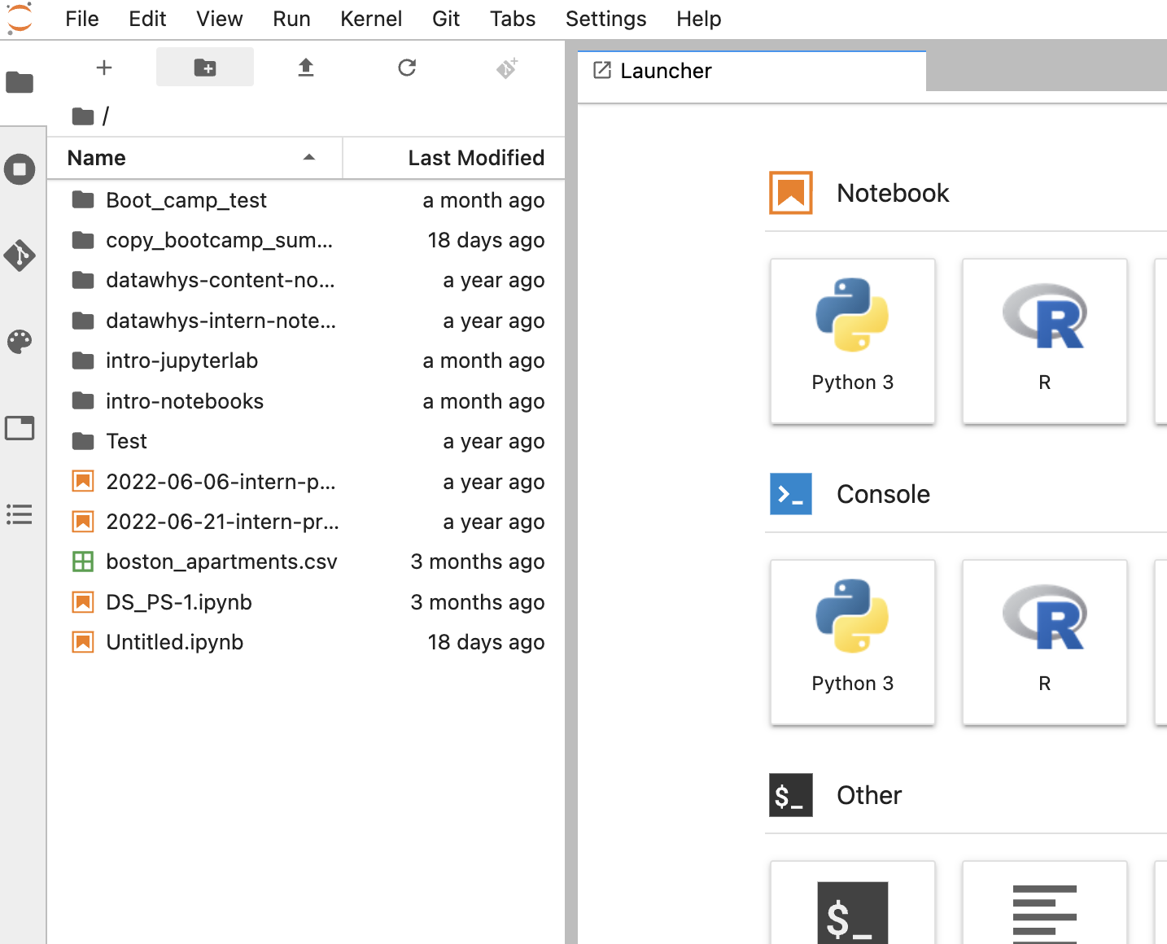
Creating a Folder
Click on the New Folder icon

Slide 11
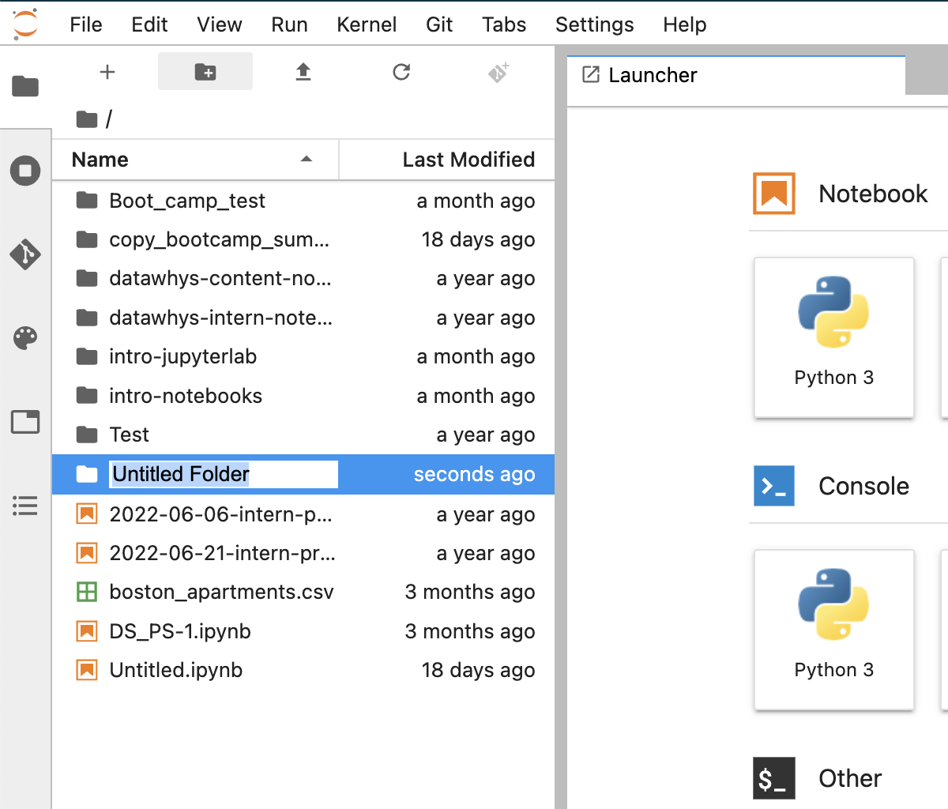
Creating a Folder
"Untitled Folder" created

Slide 12
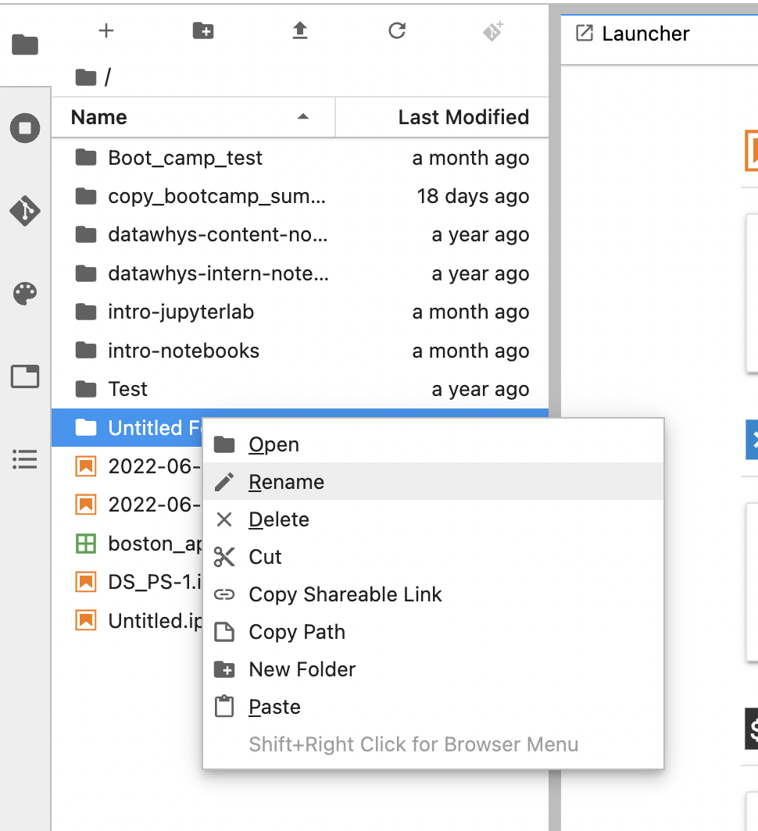
Renaming a Folder
Right click on the folder name
Click on Rename and provide desired name and press "Enter" or Click any where

Slide 13
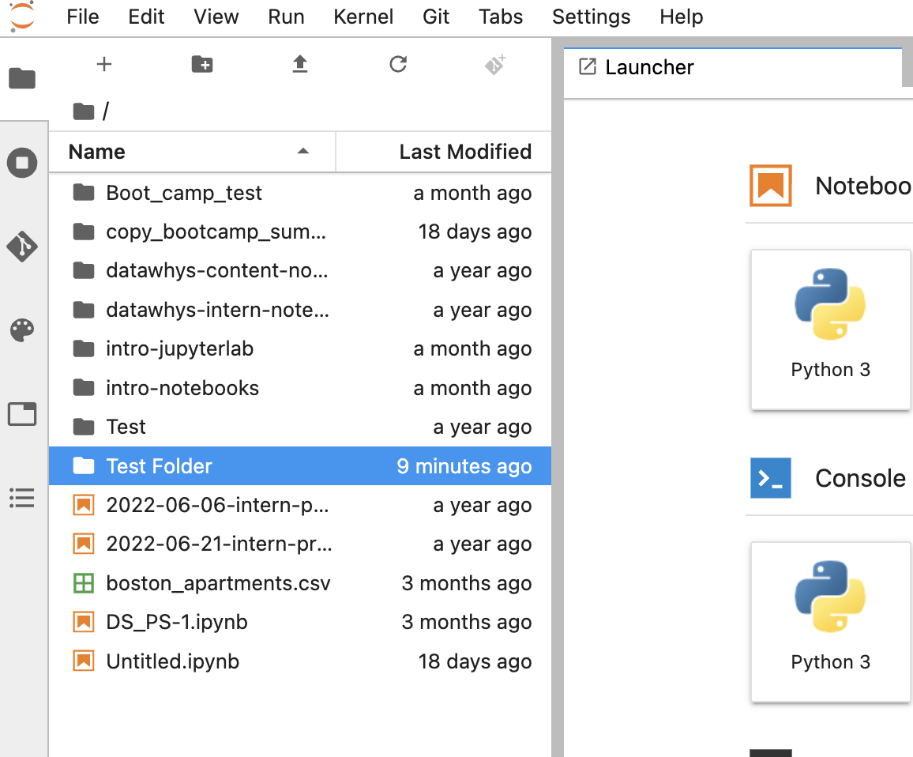
Renaming a Folder
Folder has been renamed

Slide 14

Creating and Renaming a Folder

Slide 15
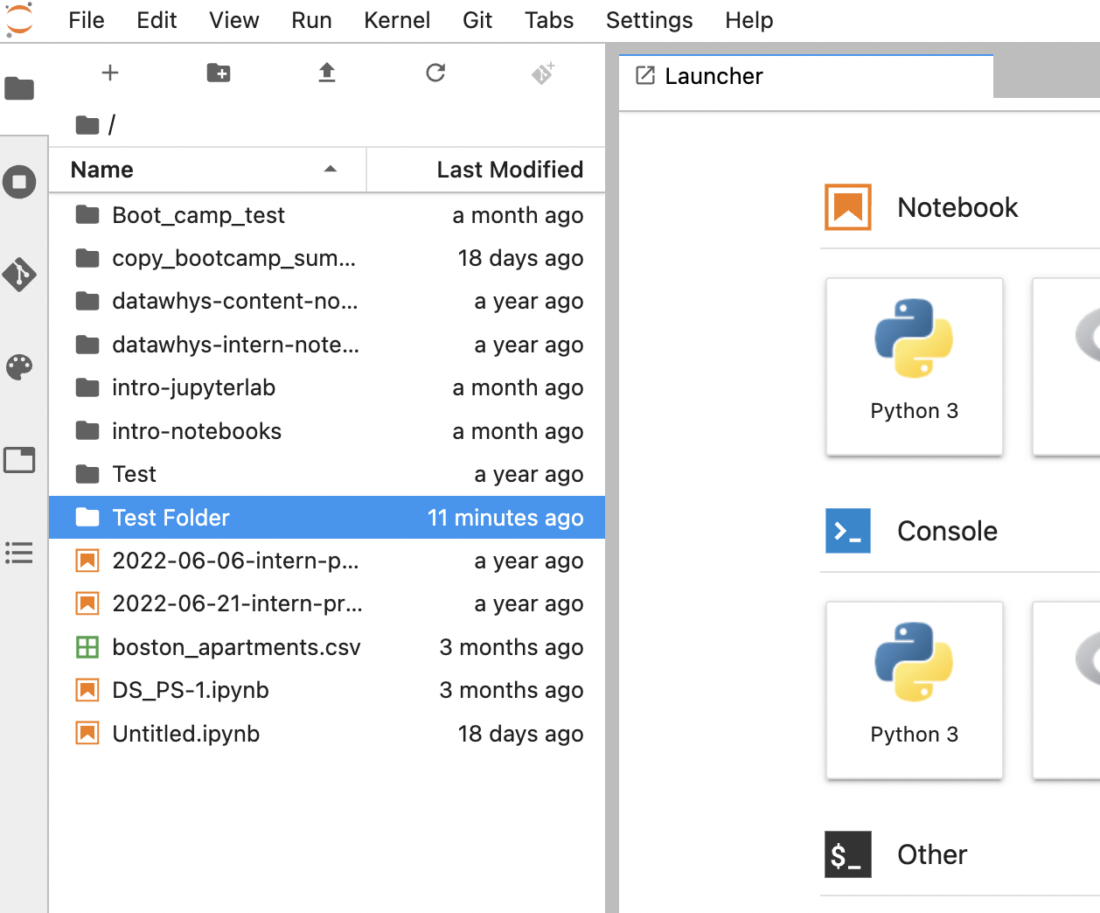
Open Folder
Before opening a new folder notice this. This shows our current location in the file system.
Double click to open a folder

Slide 16
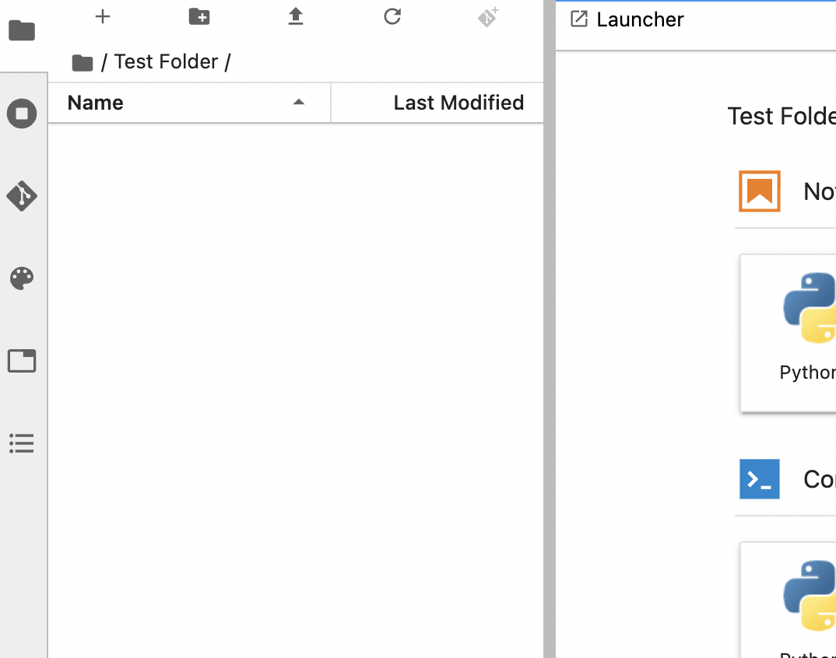
Open Folder
Indicates we are in Test Folder

Slide 17
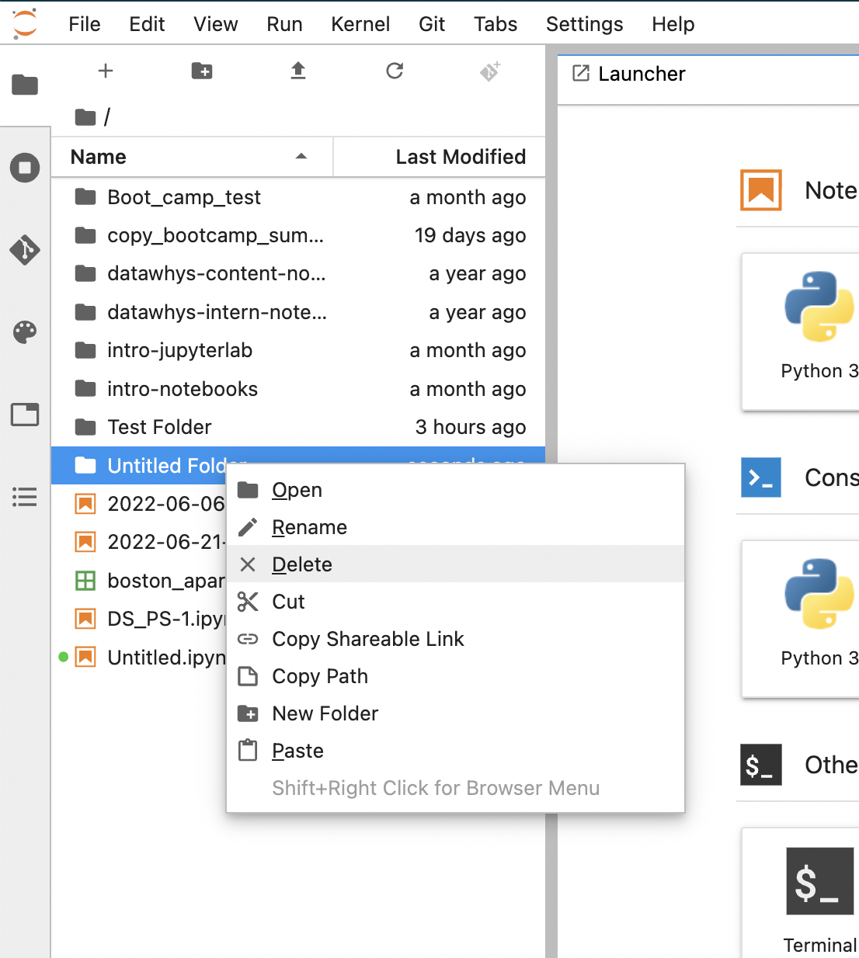
Deleting a Folder
Right click on the folder name you want to delete
Click on Delete

Slide 18
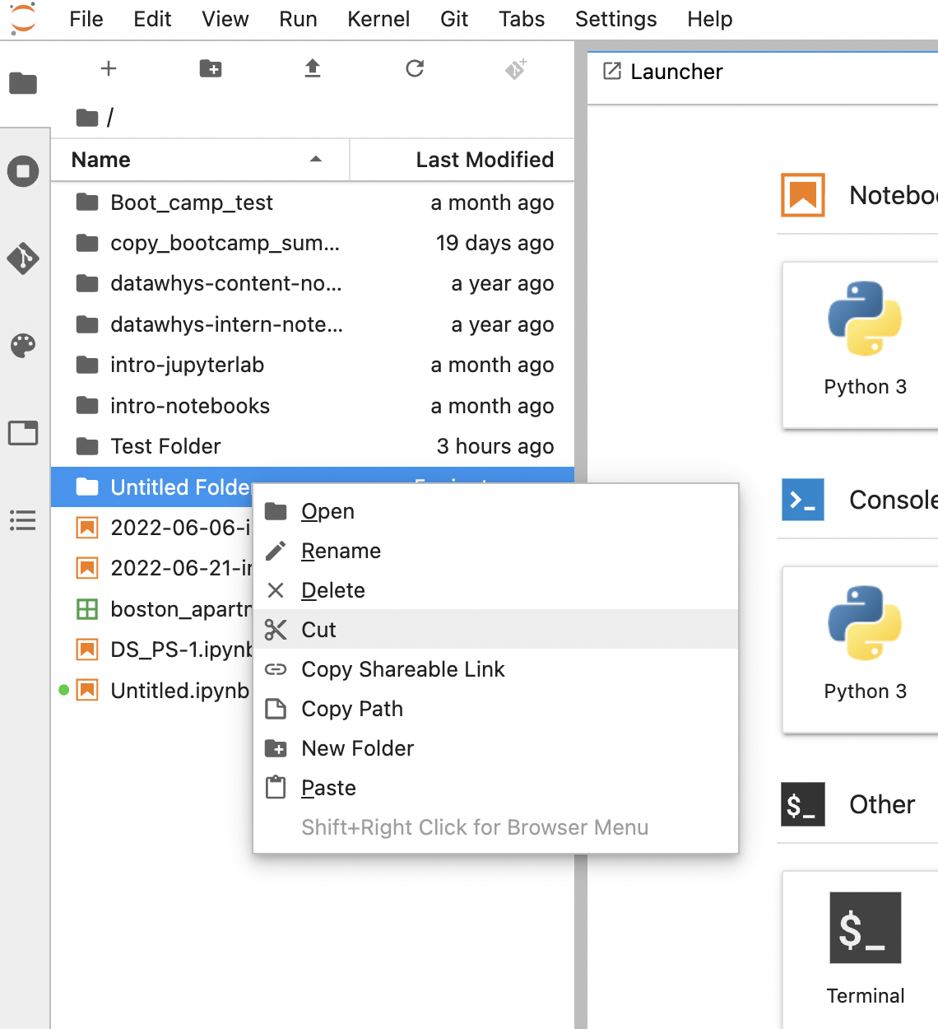
Cut a Folder
Right click on the folder name you want to cut
Click on Cut

Slide 19
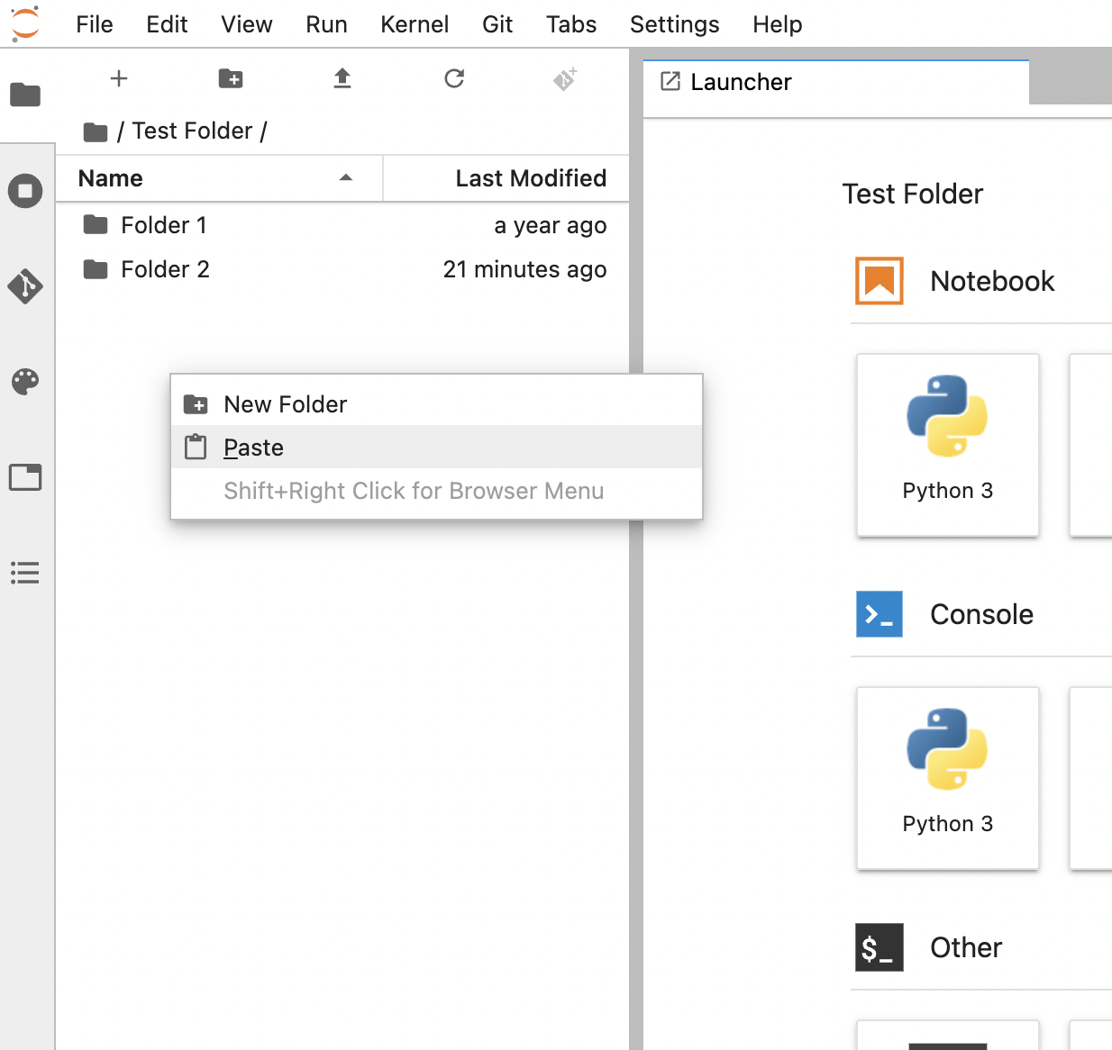
Cut a Folder
Open the folder where you want to Paste
Right click and select Paste

Slide 20
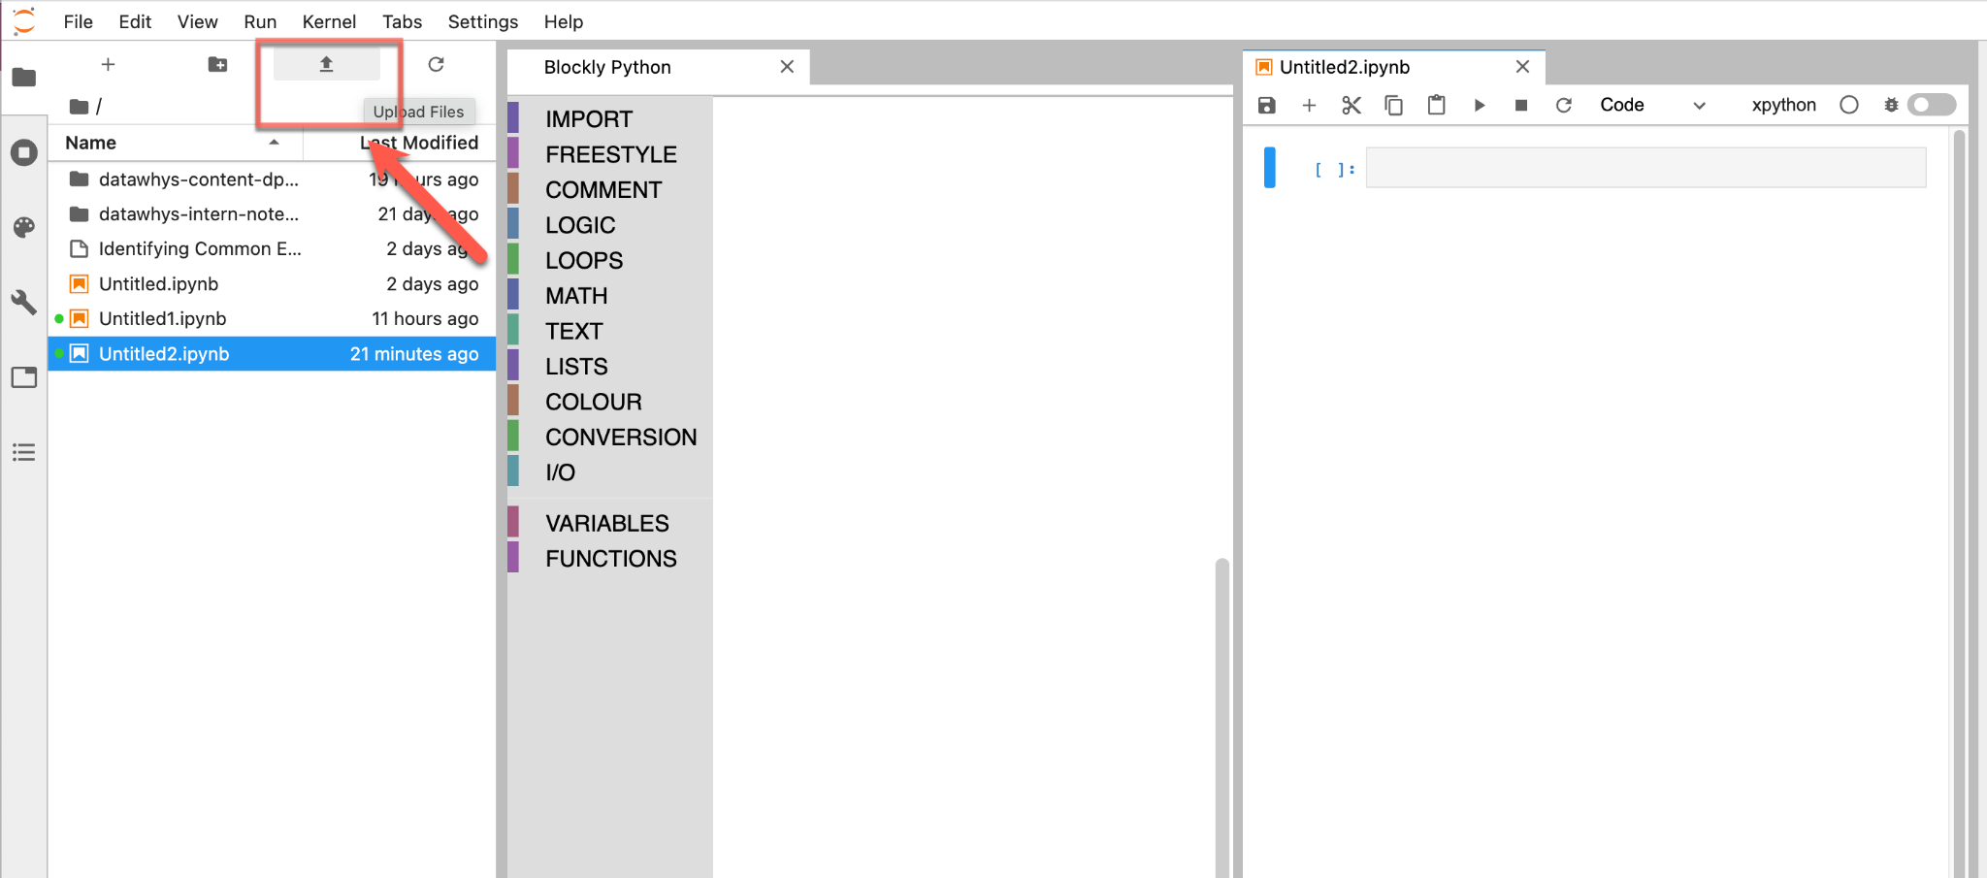
Uploading a file in Jupyterlab (1)
Click on the Upload icon (as shown by the arrow) to upload files

Slide 21
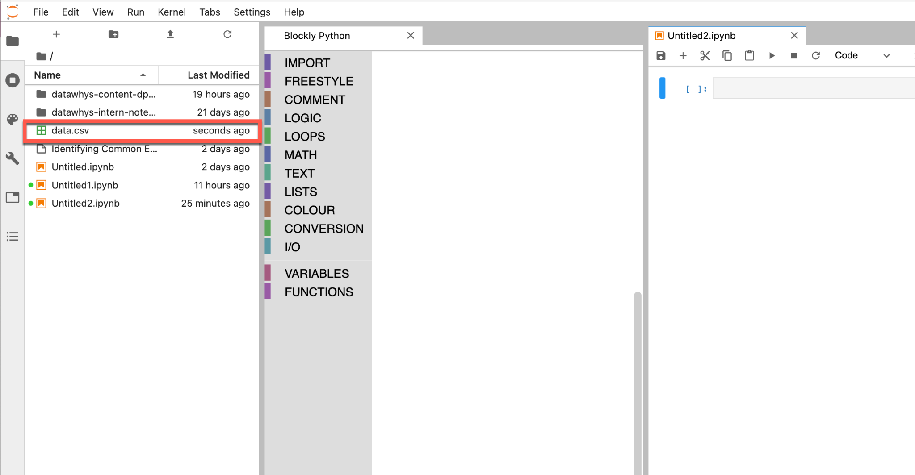
Uploading a file in Jupyterlab (2)

Slide 22
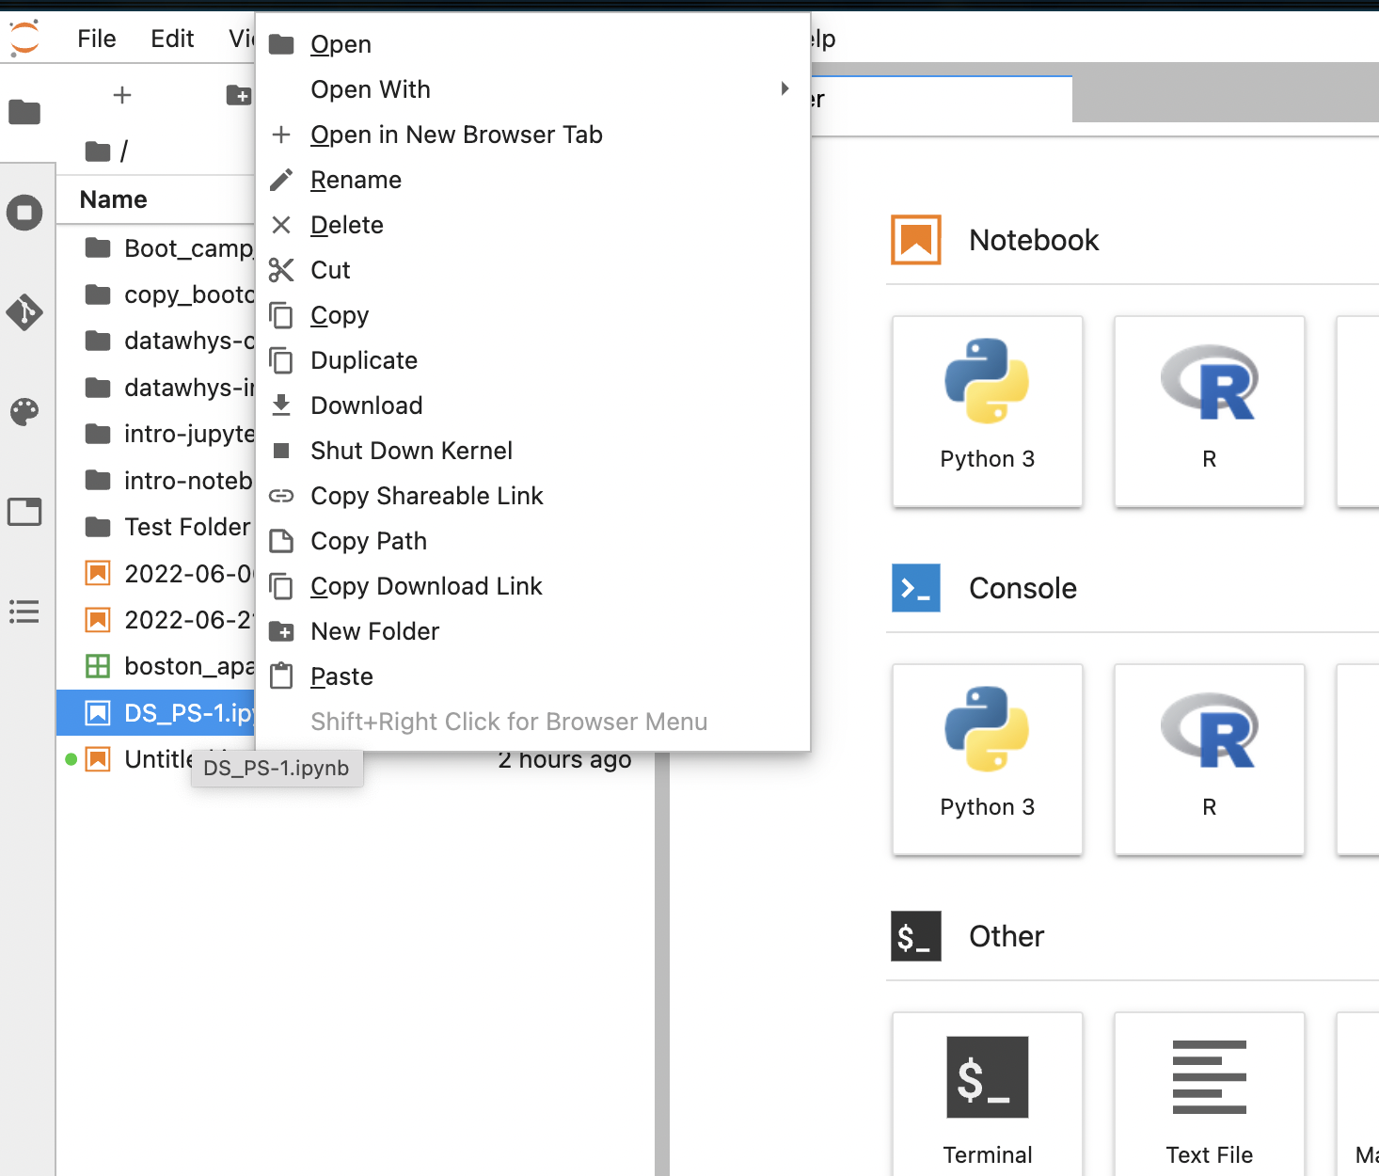
File operations
Right Click on any file to perform rename, copy, cut, delete, download etc.

Slide 23
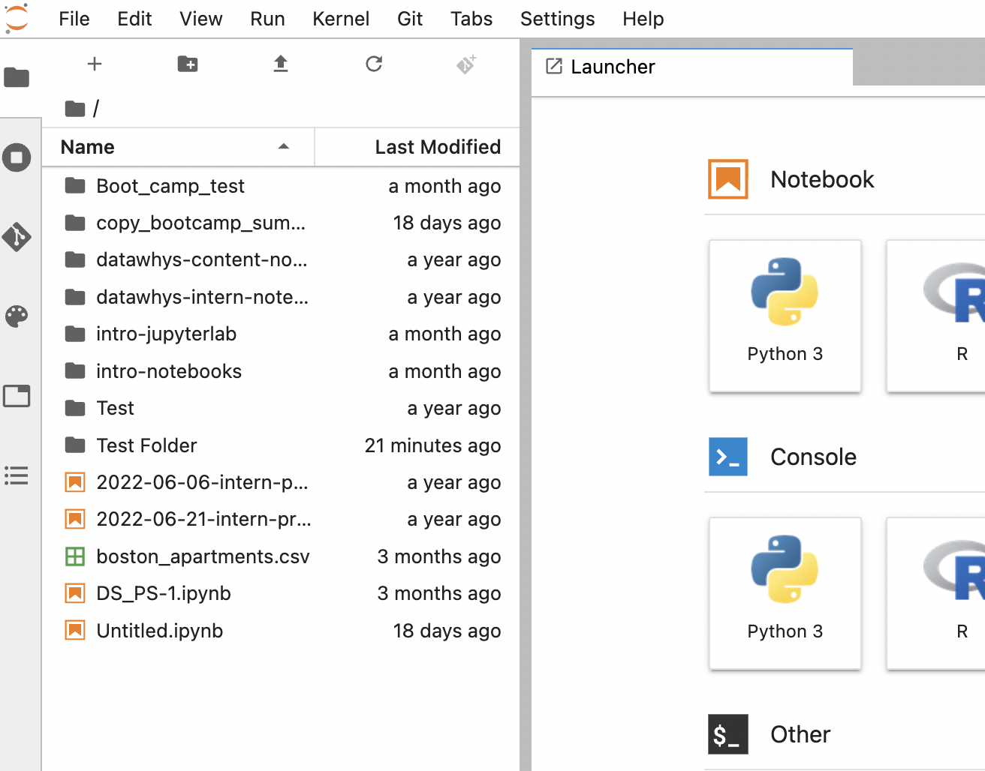
Upload a file in any specific folder
Suppose we want to upload a file in Test Folder. We've to
Open Test folder
Upload the file
Open Test Folder by double clicking

Slide 24
Upload a file in any specific folder
Indicates we are in Test Folder
Click on Upload File icon and choose a file from the device to upload

Slide 25
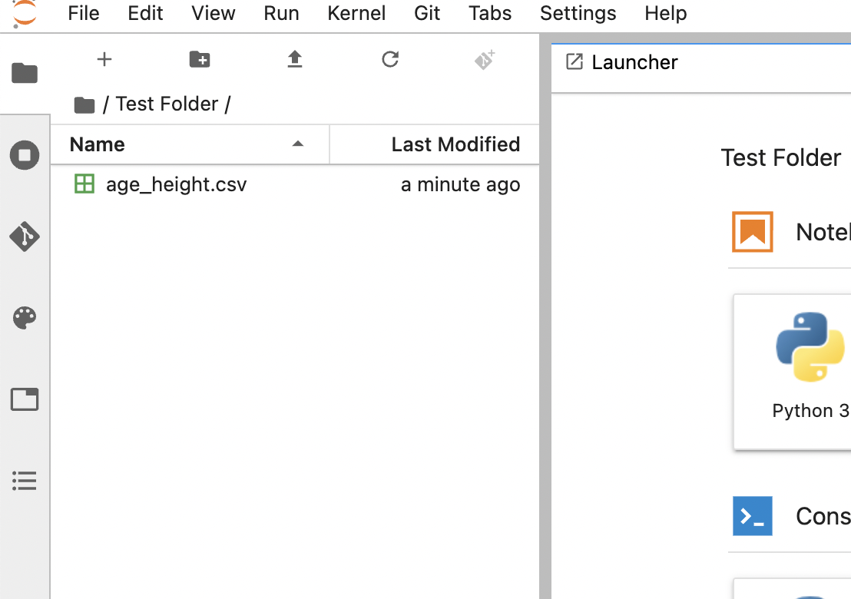
Upload a file in any specific folder
A file has been uploaded

Slide 26
File Path
A file path specifies the location of a file in a file system/structure.
They can be used to locate files.
Example: "/home/username/Documents/File1.txt".
In file system each folder is also known as "directory" and in each directory are separated with separator "/"

Slide 27
File Path
home
username
documents
File1.txt
Path: "/home/username/Documents/File1.txt".
This path indicates that in our "home" directory or folder we have "username" folder.
Within the "username" folder we have "Documents" folder.
Within the "Documents" folder we have our targeted file "File.txt".

Slide 28
File Path
home
username
documents
File1.txt
Path: "/home/username/Documents/File1.txt".
"home" is the parent directory of "username"
"username" is the parent directory of "documents"
Alternatively, we can say
"username" is the child directory of "home"
"documents" is the child directory of "username"

Slide 29
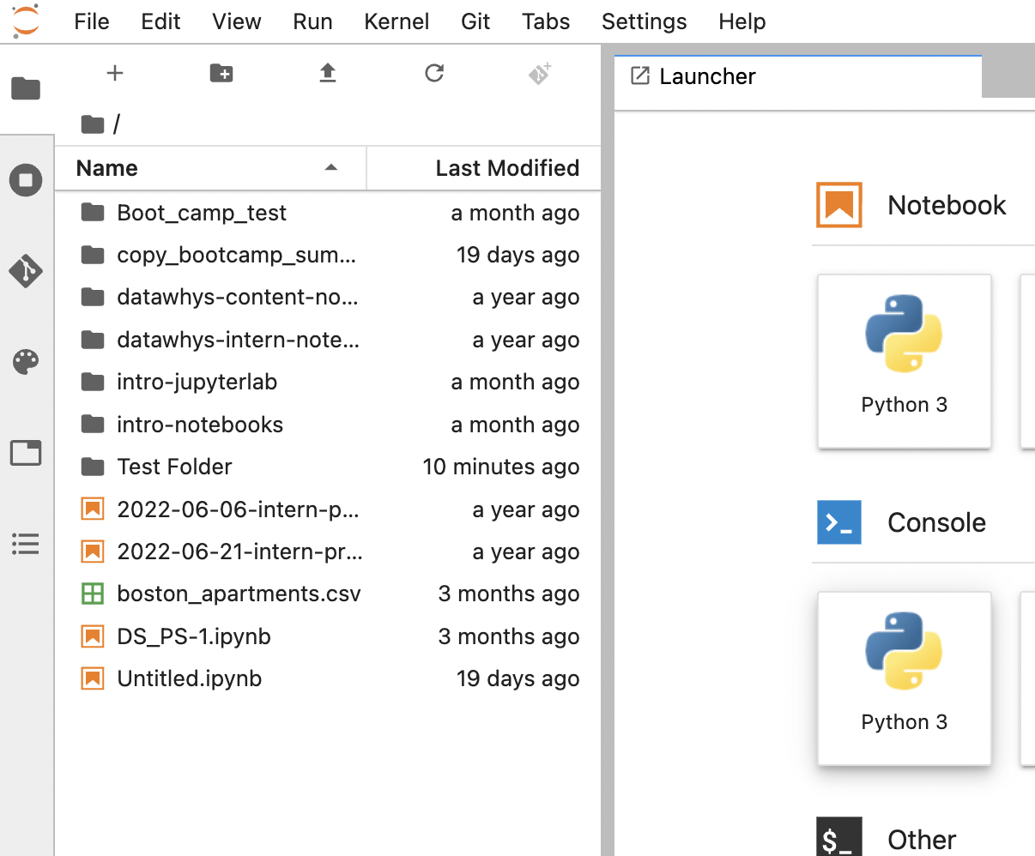
File Path in Jupyter Lab
After Login the interface shows like this
This "folder/" icon indicates root folder/directory for each user
In JupyterLab current directory is shown in this area
Let's open this folder and see

Slide 30
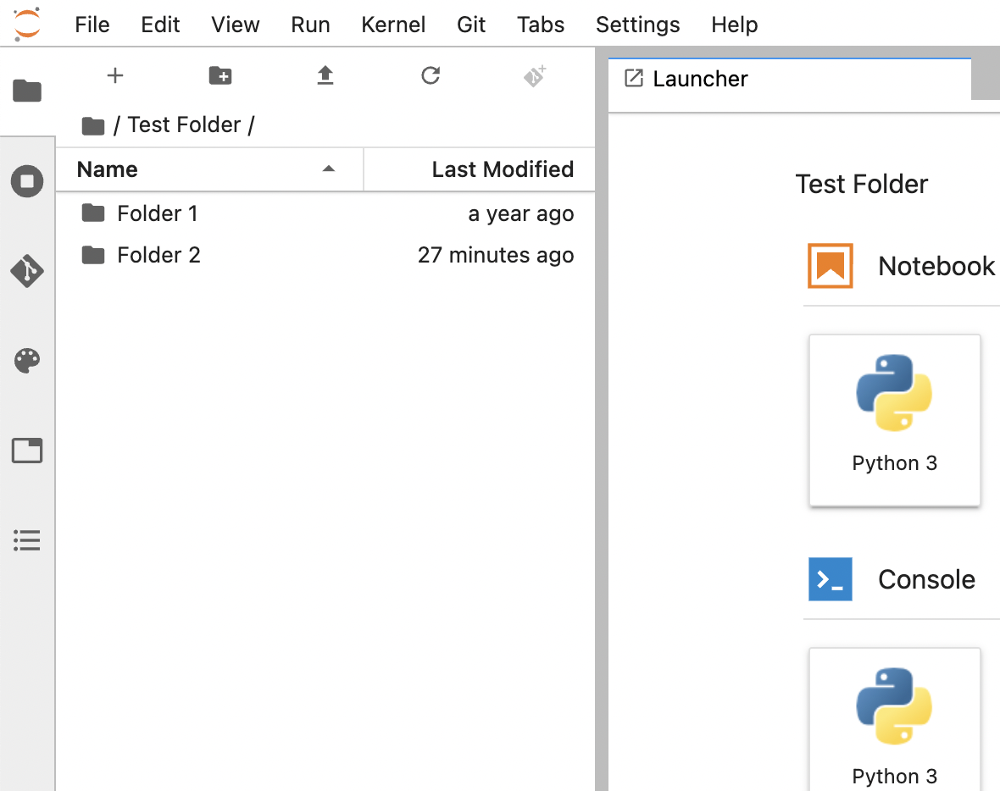
File Path in Jupyter Lab
Indicates that we are within Test Folder and current directory is Test Folder
Shows the file system of Test Folder
Let's open Folder 1 and see

Slide 31
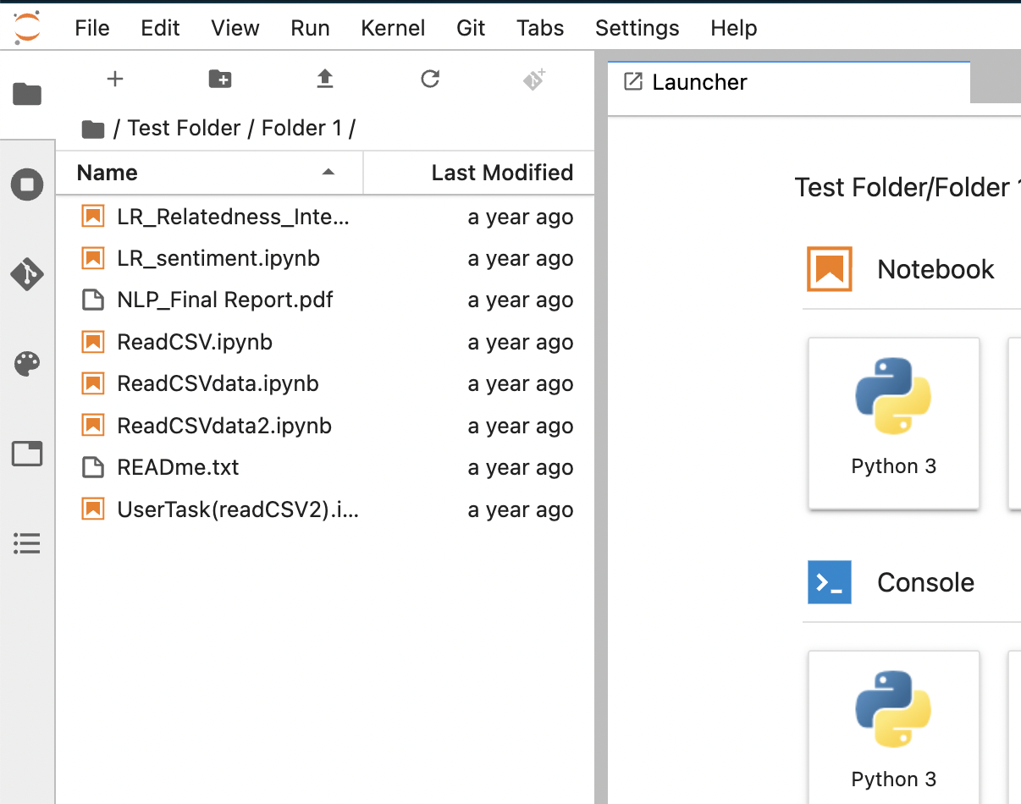
File Path in Jupyter Lab
Indicates that we are within Folder 1 and current directory is Folder 1
Shows the files within Folder 1

Slide 32
Types of File Path
Relative Path
Absolute Path

Slide 33
Relative Path
A relative path specifies the location of a file or folder relative to the current working directory.
Current directory is Folder 1
READme.txt file is located in current directory.
The relative path of this file is "READme.txt"

Slide 34
Relative Path
Test Folder
Folder 1
Universities.csv
Folder 3
Students.csv
Folder 2
Teachers.csv
Suppose we have this file structure under our root directory. And our current directory is Folder 1.
What is the relative path of Universities.csv?
Ans: "Universities.csv"
Given file structure

Slide 35
Relative Path
Test Folder
Folder 1
Universities.csv
Folder 3
Students.csv
Folder 2
Teachers.csv
Suppose we have this file structure under our root directory. And our current directory is Folder 1.
What is the relative path of Students.csv?

Slide 36
Relative Path
Test Folder
Folder 1
Universities.csv
Folder 3
Students.csv
Folder 2
Teachers.csv
Suppose we have this file structure under our root directory. And our current directory is Folder 1.
What is the relative path of Students.csv?
Notice that Students.csv is under Folder 3
Folder 3 is the child directory of Folder 1
The relative path of this Students.csv will be "Folder 3/Students.csv"
By this we go to Folder 3 as Folder 3 is child directory of Folder 1

Slide 37
Relative Path
Test Folder
Folder 1
Universities.csv
Folder 3
Students.csv
Folder 2
Teachers.csv
Suppose we have this file structure under our root directory. And our current directory is Folder 1.
What is the relative path of Teachers.csv?

Slide 38
Relative Path
Test Folder
Folder 1
Universities.csv
Folder 3
Students.csv
Folder 2
Teachers.csv
Suppose we have this file structure under our root directory. And our current directory is Folder 1.
What is the relative path of Teachers.csv?
To navigate to Teachers.csv
First ,we have to go the parent directory Folder 1 which is Test Folder. For this we use "../"
Then we go to Folder 2 which is a child directory of Test Folder. For this we use "Folder2/"
Path will be "../Folder2/Teachers.csv"

Slide 39
Absolute Path
An absolute path provides the complete location of a file or folder starting from the root directory
This "folder/" icon indicates root directory for each user
Current directory is Folder 1
The absolute path of this file is "Test Folder/Folder 1/READme.txt"
An absolute path doesn't depend on current directory

Slide 40
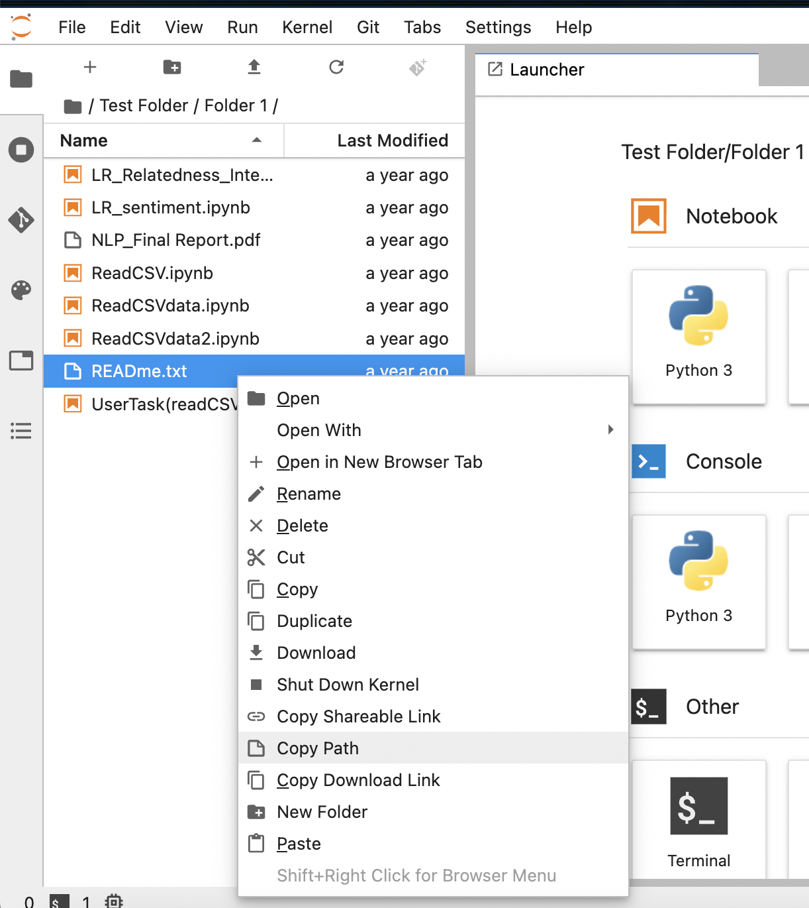
Absolute Path in JupyterLab
In JupyterLab absolute path can be obtained by "Copy Path"
Right click on a file
Clicking on "Copy Path" will copy the absolute path in the clipboard. You can paste this in any text

Slide 41
Absolute Path
Test Folder
Folder 1
Universities.csv
Folder 3
Students.csv
Folder 2
Teachers.csv
Suppose we have this file structure under our root directory.
What is the absolute path of Students.csv if our current directory is Folder 1?
What is the absolute path of Students.csv if our current directory is Folder 2?

Slide 42
Absolute Path
Test Folder
Folder 1
Universities.csv
Folder 3
Students.csv
Folder 2
Teachers.csv
Suppose we have this file structure under our root directory.
What is the absolute path of Students.csv if our current directory is Folder 1?
What is the absolute path of Students.csv if our current directory is Folder 2?
Absolute path doesn't depend on current directory. For both cases they are the same which is "Test Folder/Folder3/Students.csv"

Slide 43
Activity
Open the Activity document and proceed with the tasks

